Slide 1

Overview of Child Welfare Measures of Performance
December 19, 2019
Ohio SACWIS Project
The webinar will begin at 9:00 am

Slide 2
Agenda
Performance Measure Background
  Impetus for Dashboards
  Data
Dashboard Demo
Existing Comparative Reports
Exporting Dashboards
Questions

Slide 3
Background
In SFY 2018, total costs for children services exceeded $1B dollars
More children coming into care with more complex needs caused:
Placement Costs
Workforce
Governor DeWine and the Ohio General Assembly invested an additional
$50M in State Child Protective Service allocation
$10M to support local best practices
$5M to support foster care recruitment and retention

Slide 4
Background Continued
Over the last few months, ODJFS has partnered with:
Public Children Services Association of Ohio
Ohio Job and Family Service Association of Ohio
Ohio Job and Family Service Directors’ Association
County Commissioners Association of Ohio
County Agencies
To:
Assess Current Services
Identify Unified Goals and Outcomes
Goal:
Ensure that all of Ohio’s children have a healthy, stable family that keeps them safe.
THESE PERFORMANCE MEASURES ARE THE ESTABLISHED FRAMEWORK TO MEASURE SHORT & LONG-TERM TRANSFORMATION EFFORTS

Slide 5
System Measures:
Near-term Goal: Addressing system-wide workforce, caseload and capacity trends.
Practice Measures:
Mid-term Goal: Striving for overall improved foundational children services practices that are key to family engagement and child outcomes.
Outcome Measures:
Long-term Goal: Striving for overall improved child safety, well-being and permanency outcomes that can be achieved as we transform our system and implement the Family First Prevention Services Act.

Slide 6
Data
The Data for the Performance Measure Dashboards comes from two different sources.
SACWIS DataMart
  Intake Assessment/Screening Overview (System)
  Pending Overdue Child Abuse and/or Neglect (CA/N) Intakes (Practice)
  Timeliness of Child Abuse and/or Neglect (CA/N) Investigations (Practice)
  Children in Care by Placement Type (Outcome)
  Recurrence of Maltreatment (Outcome)
  Child Abuse/Neglect Report Recurrence (Outcome)
  Re-Entry Into Care (Outcome)
  Children Aging Out of Care (Outcome)
Oracle Database
  Caseworker Caseload Estimates (System)
  Caseworker Counts (System)
  Transfers to Ongoing by Risk Level (System)
  Safety Assessment Completion (Practice)
  Family Assessment Completion (Practice)
  Initial Case Plan Completion (Practice)
  Caseworker Visits with Children (Practice)
  Caseworker Visits with Adults (Practice)

Slide 7
Data Continued
Data will be refreshed automatically every 24 hours.
Dashboard views will default to the last FULL quarter of data. The next quarter of data will be available as a partial quarter. Data for the partial quarter may seem incorrect based on how and when the data is entered into SACWIS.
There is no Personally Identifying Information (PII) included in the data tables, thus no PII can be transmitted from the database to the Tableau Server.
The data included in the dashboards has been aggregated by agency and periodicity.
A SOUID is required to access the Performance Measure dashboards. In addition, the SOUID will need to be approved by ODJFS Business Intelligence/Office of Family and Children staff prior to access being granted.
All dashboard users have been granted secure access to the dashboards. The Office of Families and Children will be provisioning access to the dashboards using the contacts in your agency’s distribution list for the Comprehensive Visitation Report.

Slide 8
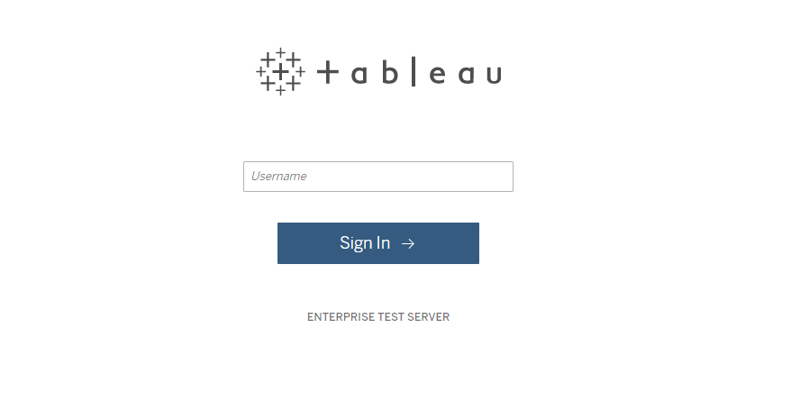
Enter your 8 digit SOUID number in this field

Slide 9
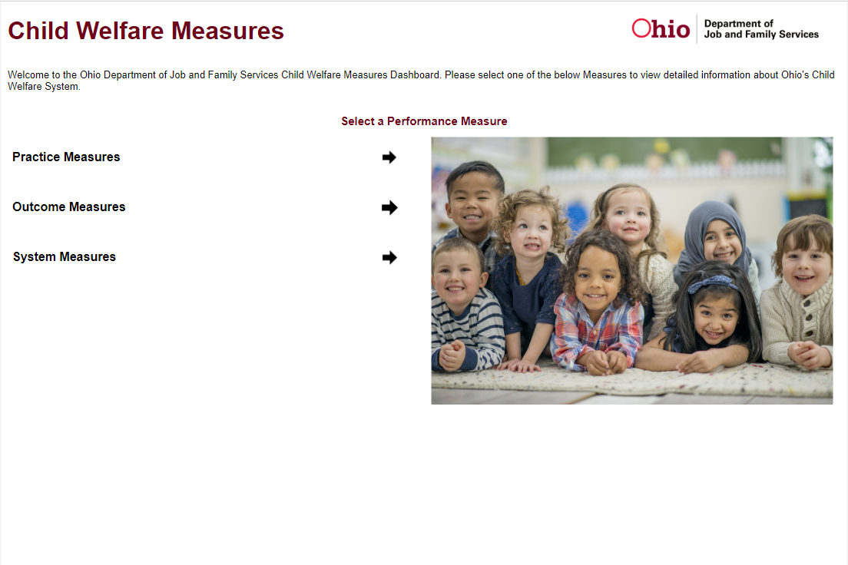
From this Launch Page, the user will be able to select which of the three sets of measures they wish to view.

Slide 10
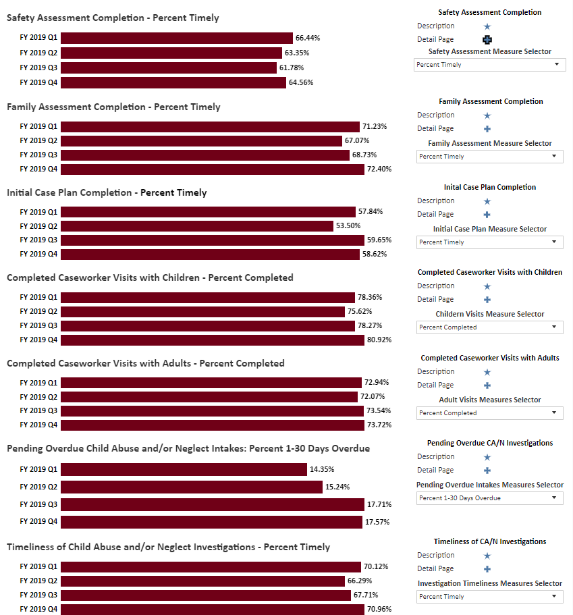
Each set of Performance Measures has a Summary page where the individual reports can be viewed and manipulated.

Slide 11
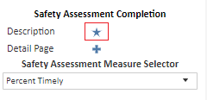
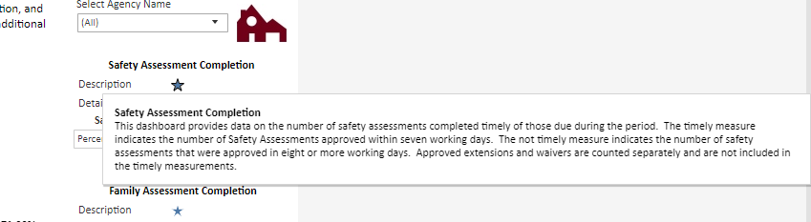
Each Practice Measure dashboard has a “Description” hover feature which will tell the user what the individual dashboard is measuring. This description also details what constitutes “timely” or “completed” for applicable dashboards.

Slide 12
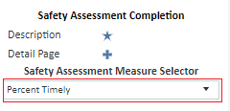
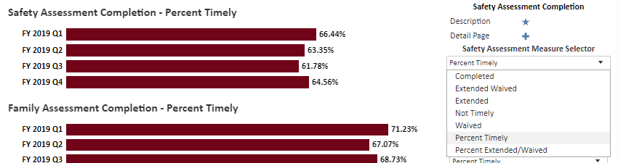
Each Practice Measure dashboard has a dropdown feature on the Summary page that allows the user to manipulate the data on the Summary page screen

Slide 13
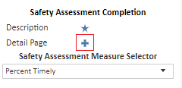
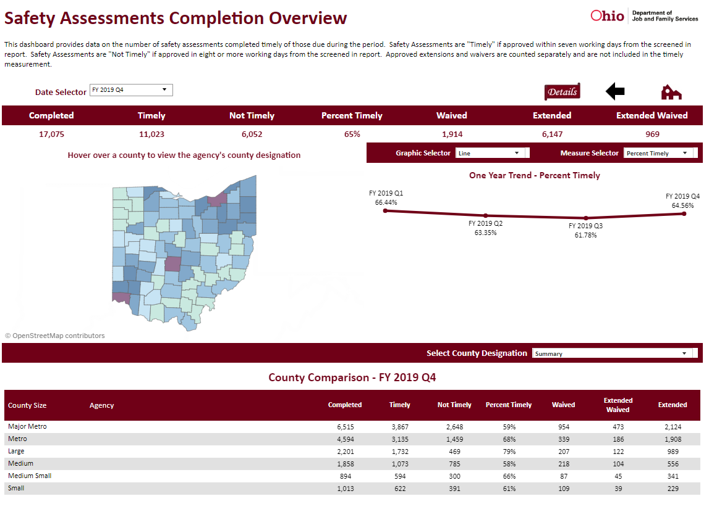
Clicking on the “Detail Page” link will take the user to the overview page for the individual Performance Measure dashboard.

Slide 14
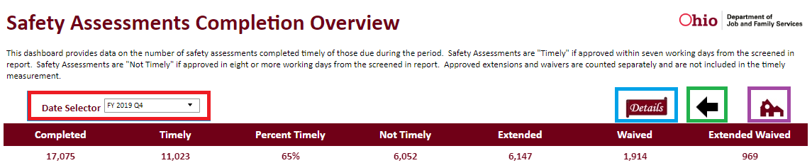
Each Performance Measure Overview includes:
“Date Selector” to choose a quarter to view Statewide data (manipulates the top row of data below)
“Details” button to drill down to the detail screen
“Back” button that returns the user to the Summary Page
“Home” button that returns the user to the launch page

Slide 15
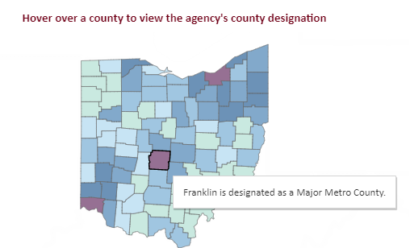
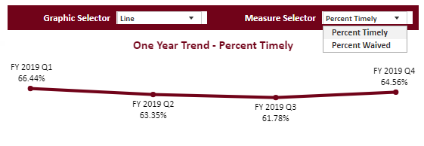
Each Summary Page includes a map that allows the user to identify each county by size designation
Each Summary Page includes a trend line that allows the user to display different percentage trends over time
(bar and line graph options)

Slide 16
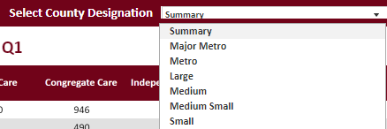
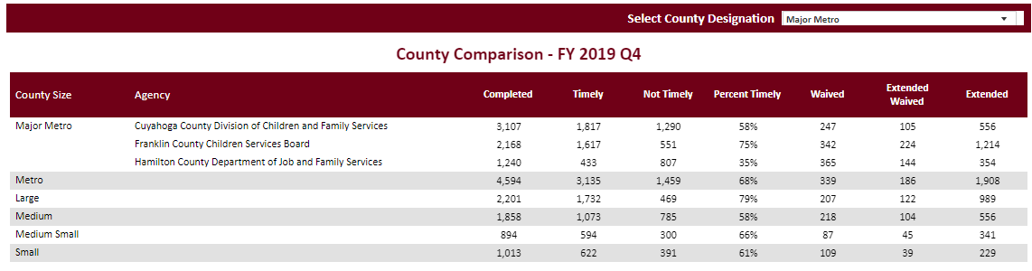
Each Summary Page includes a County Comparison that will allow the user to compare data from similar sized counties

Slide 17
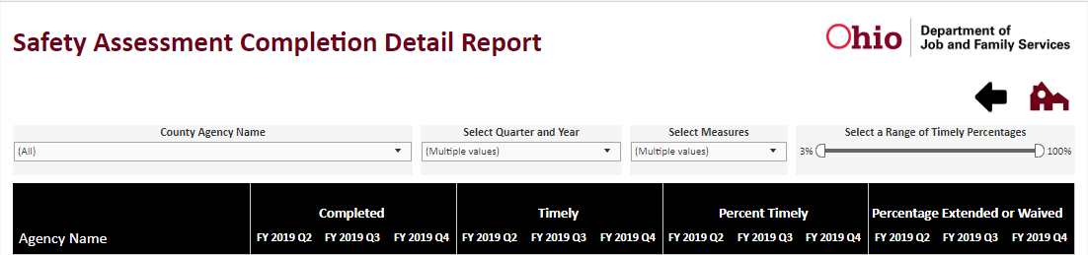
Each Performance Measure Detail Includes:
County Agency Name – allows the user to select ALL counties or any combination of individual counties.
Select Quarter and Year – allows the user to select any combination of available quarter/year combinations.
Select Measures – allows the user to select any of the Measure Values found in the data. These Measure Values will be the same as the available drop down options on the summary page.
Select a Range – the slider filter allows the user to adjust the range of values displayed so that only values within a certain percentage display (not available on all Detail Pages)

Slide 18
System Measures
Caseworker Caseload Estimates – estimation of the average caseload of workers who have been employed by the agency for at least one year as of the end of the quarter.
Caseworker Counts – the number of employees as of the last day of the quarter who have an active case assignment with the role of primary worker, caseworker, assessor investigator or assessment investigation worker.
Intake Assessment/Screening Overview – the number of CA/N or FINS – Stranger Danger intakes received during the period, how many of those intakes were Screened In and Screened In AR, and the percentage that were Screened In and Screened In AR based on the intakes received date.
Transfers to Ongoing by Risk Level – count and percentage of cases transferring for Ongoing services based on the Family Assessment actuarial tool risk level.

Slide 19
System Measure Comparative Reports
SYSTEM MEASURES | ROM Reports | SACWIS Reports | LOCATION
Caseworker Caseload Estimates |  | Case Load Summary | SACWIS Administration Report
Caseworker Counts |  | SACWIS User Report | SACWIS Administration Report
Intake Assessment/Screening Overview | Child Protection Reports | SACWIS Intake Search (utilizing dropdown filters) | ROM SACWIS Intake Search
Transfers to Ongoing by Risk Level |  | Family Assessment Risk Contributor Report | SACWIS Administration Report

Slide 20
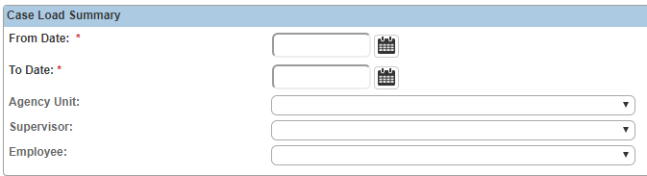
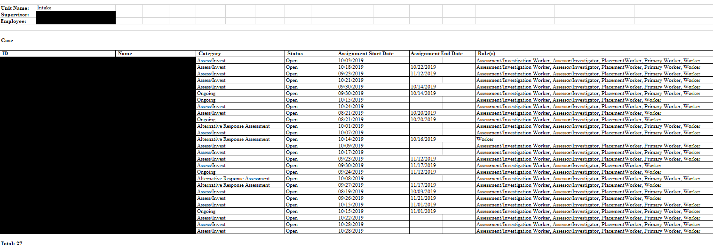
Case Load Summary Report (SACWIS)
to compare
Caseworker Caseload Estimates

Slide 21
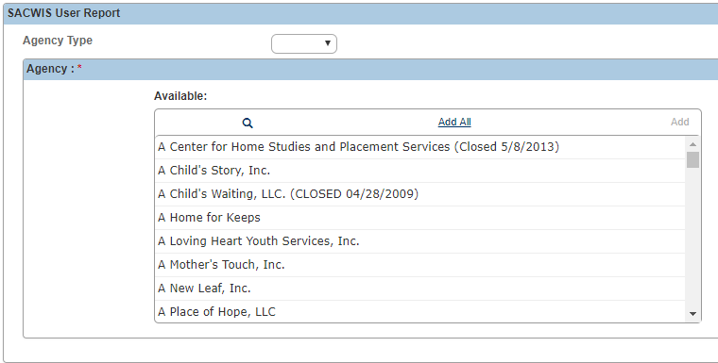
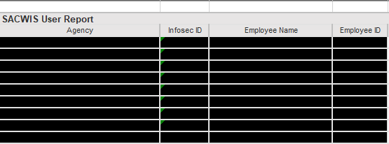
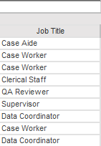

SACWIS User Report (SACWIS)
to compare
Caseworker Counts

Slide 22
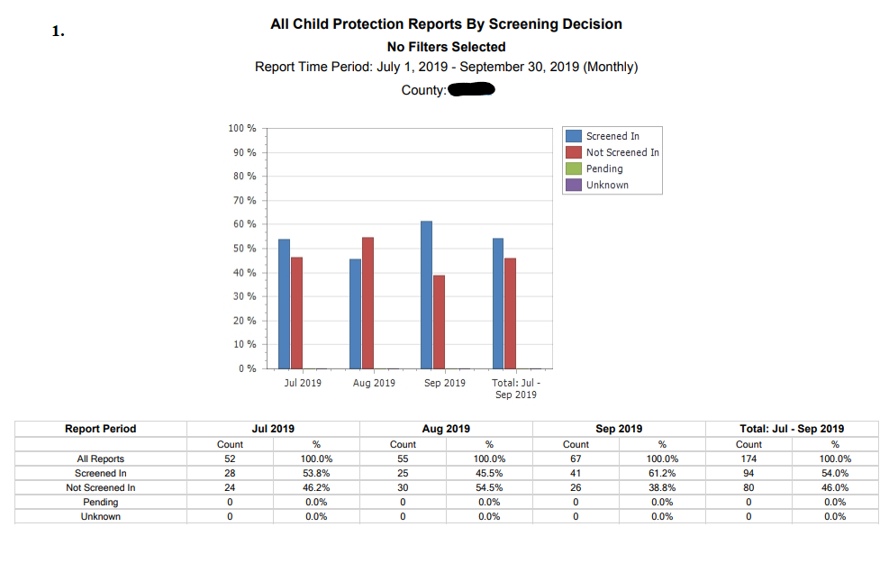
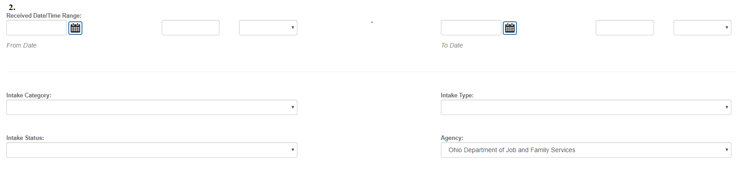
1. Child Protection Reports (ROM)
and
2. SACWIS Intake Search Functionality (SACWIS)
to compare
Intake Assessment/Screening Overview

Slide 23
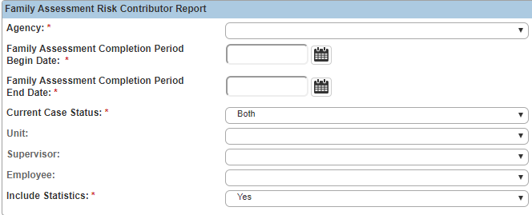
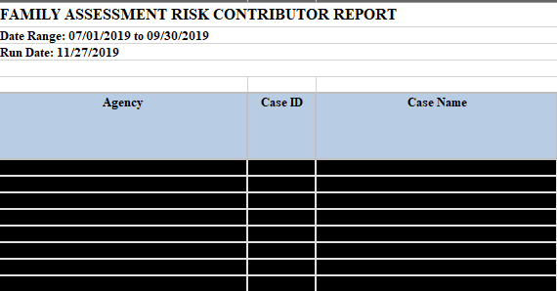
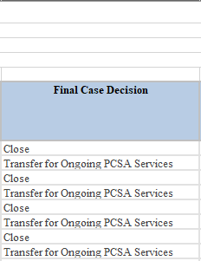
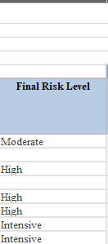
Family Assessment Risk Contributor Report (SACWIS)
to compare
Transfers to Ongoing by Risk Level

Slide 24
Practice Measures
Safety Assessment Completion – the number of Safety Assessments completed timely of those completed during the period.
Family Assessment Completion – the number of Family Assessments completed timely of those completed during the period.
Initial Case Plan Completion – the number of Initial Case Plans completed timely of those completed during the period.
Caseworker Visitation with Children – completed caseworker visits with children on open cases
Caseworker Visitation with Adults – completed caseworker visits with adults on open cases
Pending Overdue Child Abuse and/or Neglect (CA/N) Intakes – the number of CA/N intakes where the Assessment/Investigation (AI) is not completed and overdue as of the last day of the period.
Timeliness of Child Abuse and/or Neglect (CA/N) Investigations – the number of Assessment/Investigations of CA/N Intakes completed timely of those due during the period.

Slide 25
Practice Measure Comparative Reports
PRACTICE MEASURES | ROM Reports | SACWIS Reports | LOCATION
Safety Assessment Completion |  | Intake Assessment Lifecycle Report for Child Abuse, Neglect and Dependency | SACWIS Administration Report
Family Assessment Completion |  | Intake Assessment Lifecycle Report for Child Abuse, Neglect and Dependency Family Assessment Risk Contributor Report | SACWIS Administration Report
Initial Case Plan Completion |  | Initial Case Plan Timeliness Report (in development) | SACWIS Administration Report
Completed Caseworker Visits with Child |  | Comprehensive Visitation Report | SACWIS Administration Report
Completed Caseworker Visits with Adults |  | Comprehensive Visitation Report | SACWIS Administration Report
Pending Overdue CA/N Intakes | Pending CPS Reports |  | ROM
Timeliness of CA/N Investigations | Investigations Completed Within Required Time |  | ROM

Slide 26
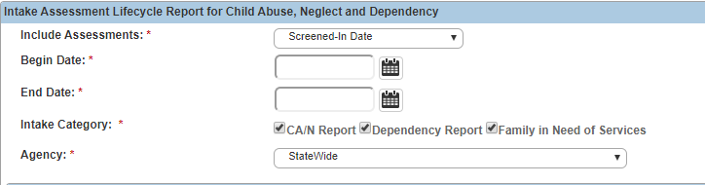
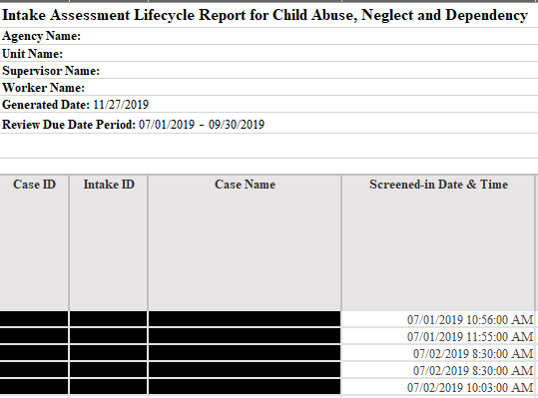
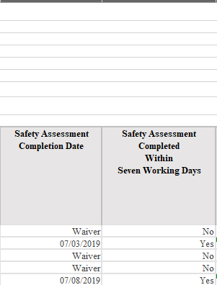
Intake Assessment Lifecycle Report for CA/N (SACWIS)
to compare
Safety Assessment Completion

Slide 27
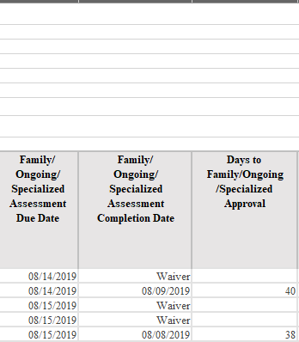
Intake Assessment Lifecycle Report for CA/N (SACWIS)
to compare
Family Assessment Completion

Slide 28
Intake Assessment Lifecycle Report for CA/N (SACWIS)
to compare
Family Assessment Completion

Slide 29
Intake Assessment Lifecycle Report for CA/N (SACWIS)
to compare
Family Assessment Completion

Slide 30
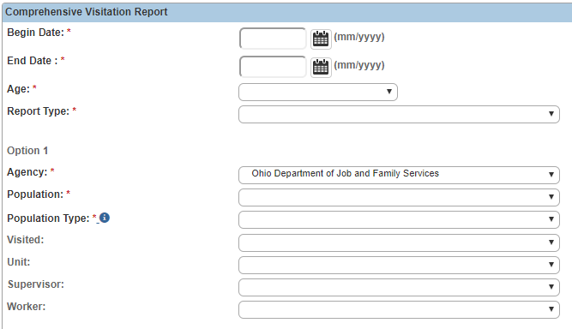
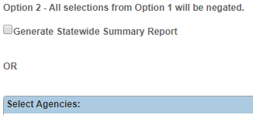
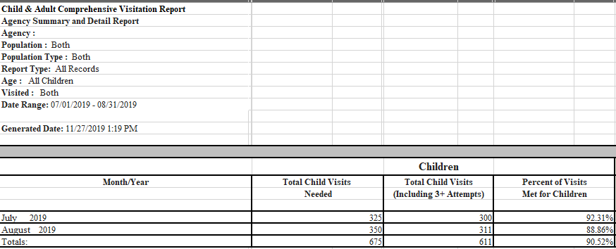
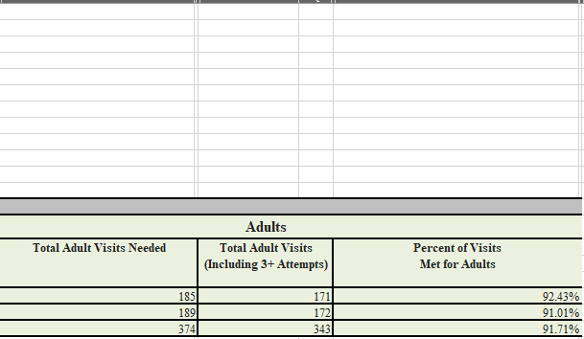
Comprehensive Visitation Report (SACWIS)
to compare
Completed Visits with Children and
Completed Visits with Adults

Slide 31
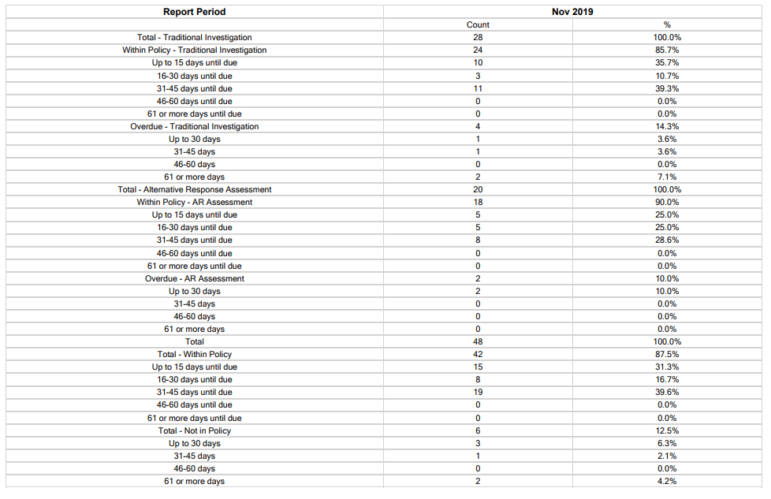
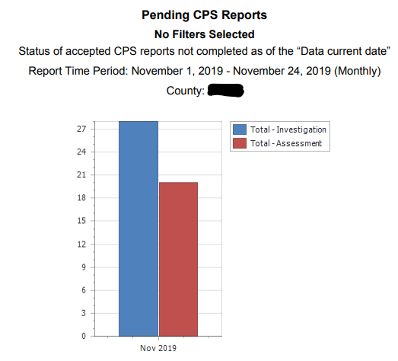
Pending CPS Reports (ROM)
to compare
Pending Overdue Child Abuse and/or Neglect Intakes

Slide 32
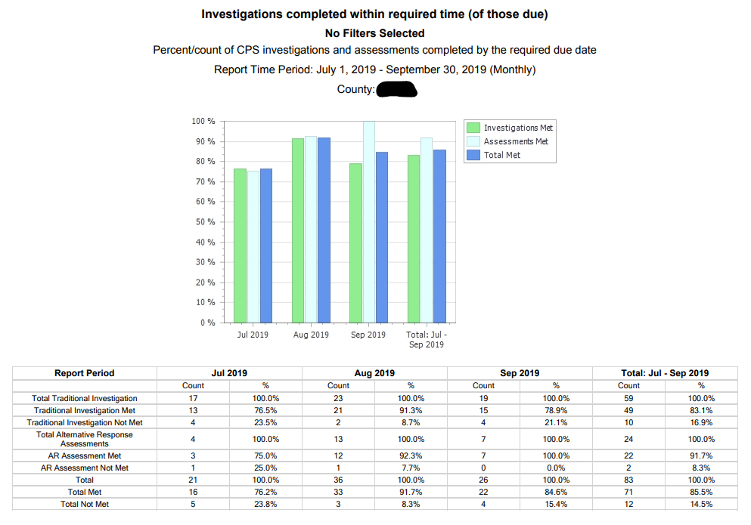
Investigations Completed Within Required Time (ROM)
to compare
Timeliness of CA/N Investigations

Slide 33
Outcome Measures
Children in Care by Placement Type – count of children in care by placement type as of the last day of the reporting period.
Recurrence of Maltreatment (requires a 24 month measurement period) – within the first 12 months, the report finds a child victim of a substantiated or indicated report. If the child is then a victim of a substantiated or indicated maltreatment allegation within the next 365 days, the child has experienced recurrence of maltreatment.
Child Abuse/Neglect Report Recurrence (requires a 24 month measurement period) – within the first 12 months the report finds an Alleged Child Victim (ACV) or Child Subject of the Report (CSR) of a screened in Child Abuse/Neglect (CA/N) report. If the child is an ACV or CSR on a subsequent screened in CA/N report that occurs within the next 365 days then that child is counted as having report recurrence.
Re-Entry Into Care (requires a 13 month measurement period) – within the first month, a child exits care. If the child re-enters care within the next 12 months following exit, the child is counted as having re-entered care.
Children Aging Out of Care – the number of children discharged from care during the reporting period who were 18 years or older on the day of their discharge.

Slide 34
Outcome Measures Comparative Reports
OUTCOME MEASURES | ROM Reports | LOCATION
Children in Care by Placement Type | Placement Type | ROM
Recurrence of Maltreatment | (Federal) Recurrence of Maltreatment | ROM
CA/N Report Recurrence | CPS Report Recurrence | ROM
Re-Entry Into Care | Permanency Maintained 12 Months | ROM
Children Aging Out of Care | Discharge Reason Site (utilizing age filter) | ROM

Slide 35
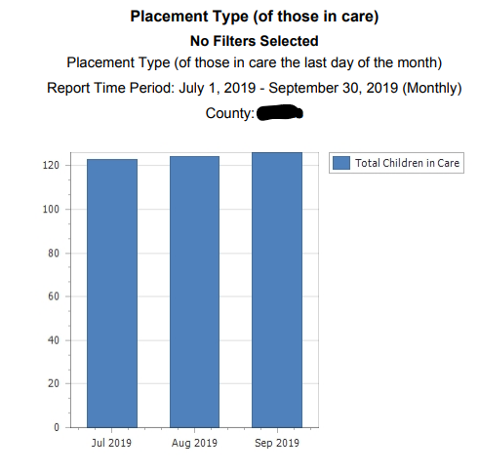
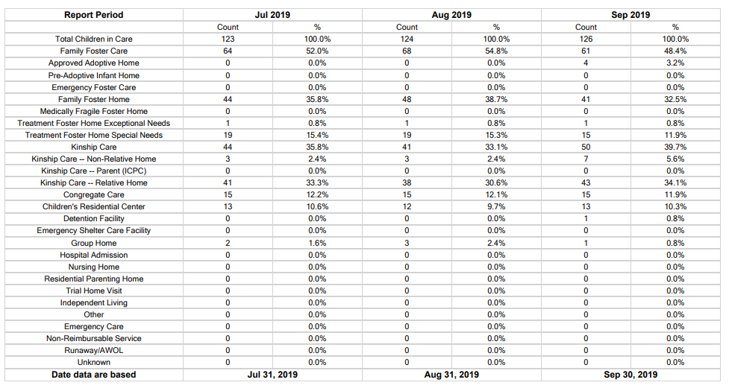
Placement Type (ROM)
to compare
Children in Care by Placement Type

Slide 36
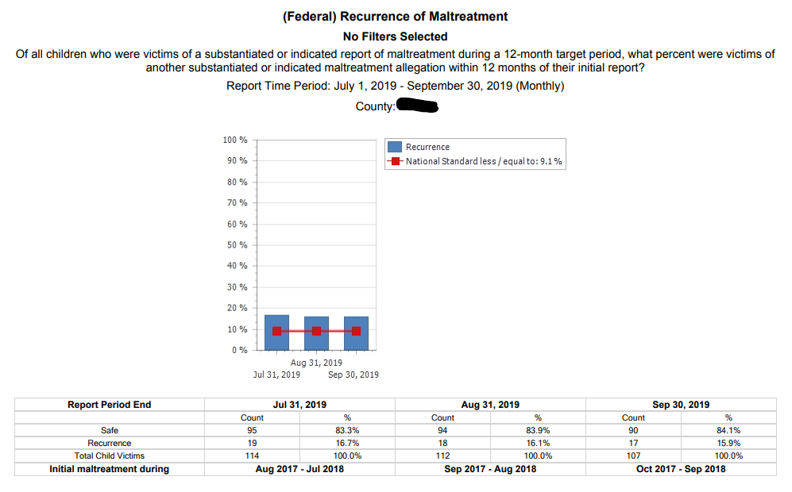
(Federal) Recurrence of Maltreatment (ROM)
to compare
Recurrence of Maltreatment

Slide 37
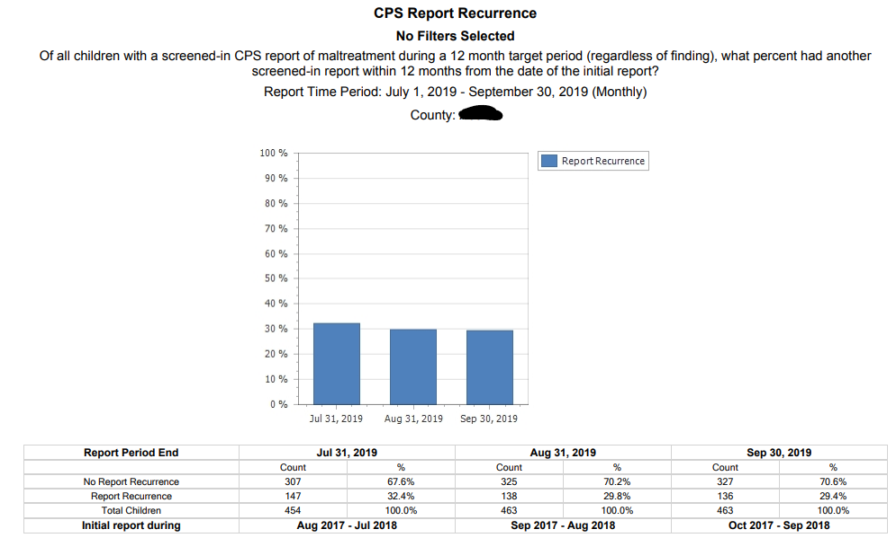
CPS Report Recurrence (ROM)
to compare
CA/N Report Recurrence

Slide 38
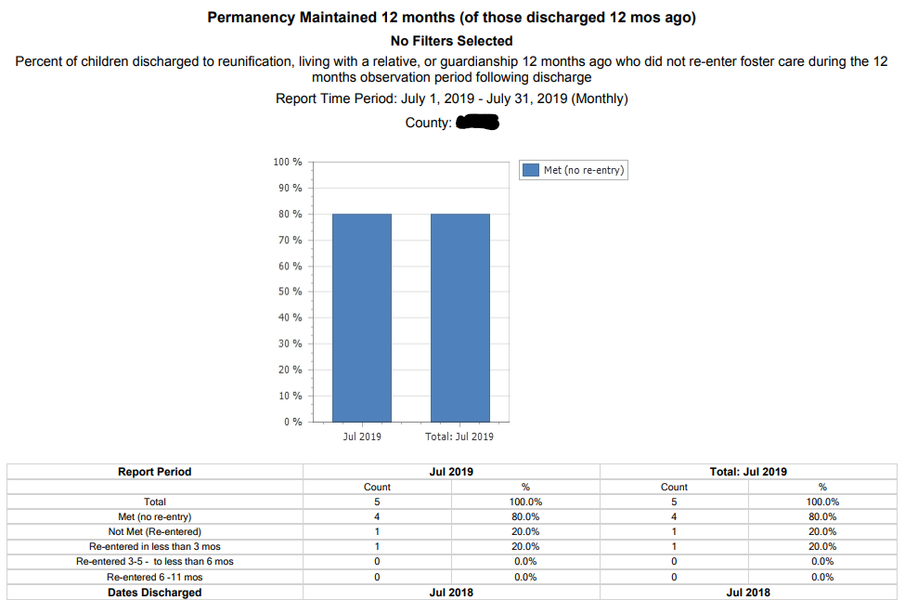
Permanency Maintained 12 Months (ROM)
to compare
Re-entry Into Care

Slide 39
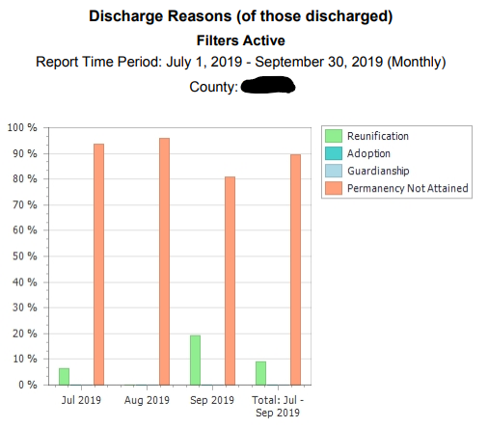
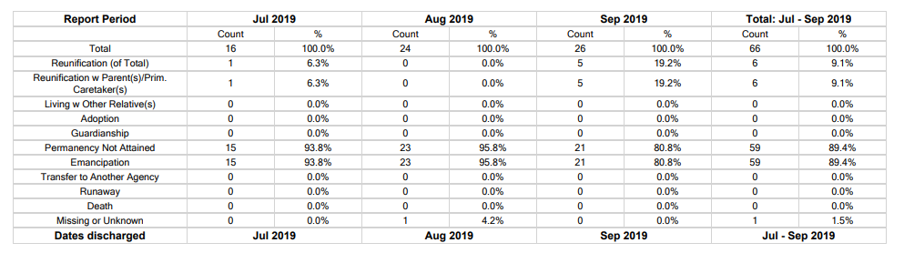
Discharge Reasons (ROM)
to compare
Children Aging Out of Care

Slide 40
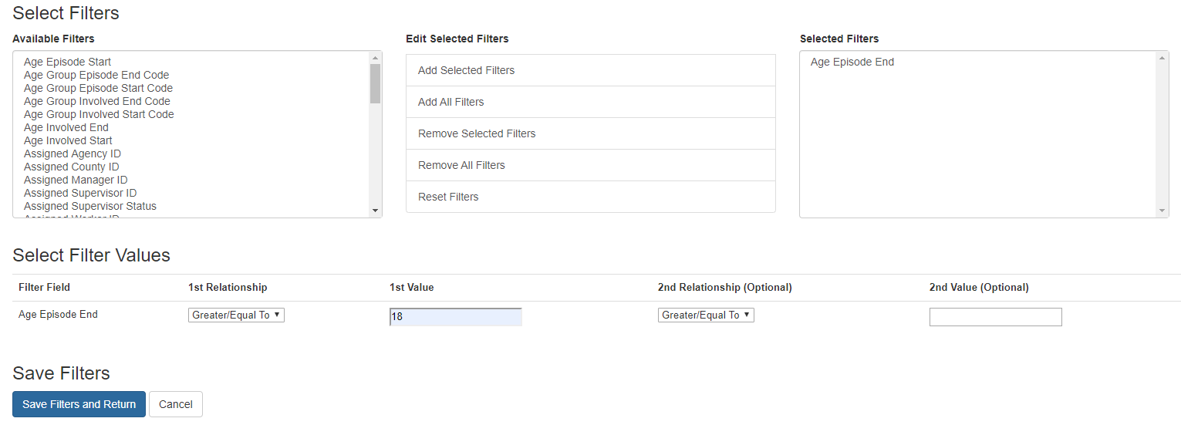
This filter should be added to Discharge Reasons to only view the data related to 18+ discharges

Slide 41
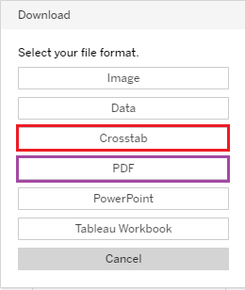
Utilizing Export Function in Tableau
Use Crosstab option for Detail page export
Use PDF option for Summary/Overview page export

Slide 42
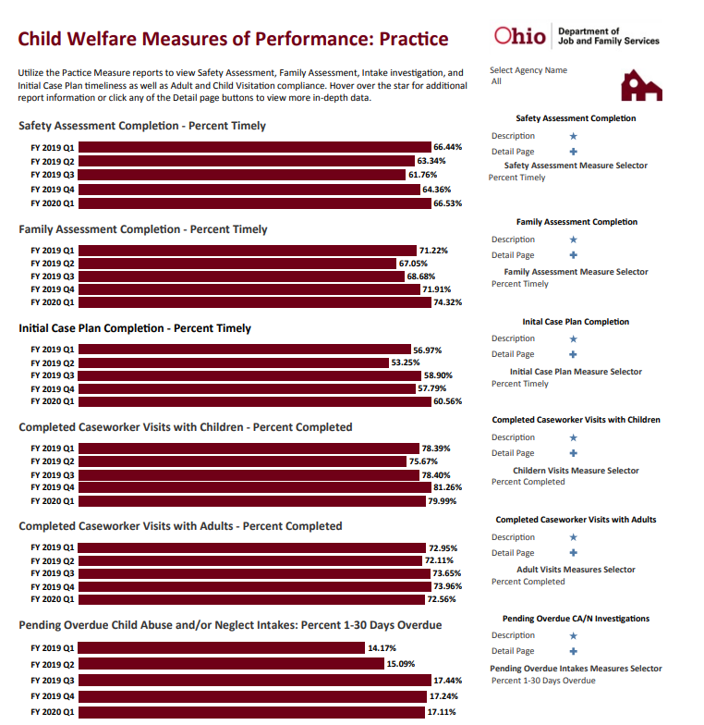
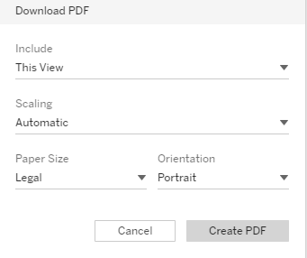
PDF Summary

Slide 43
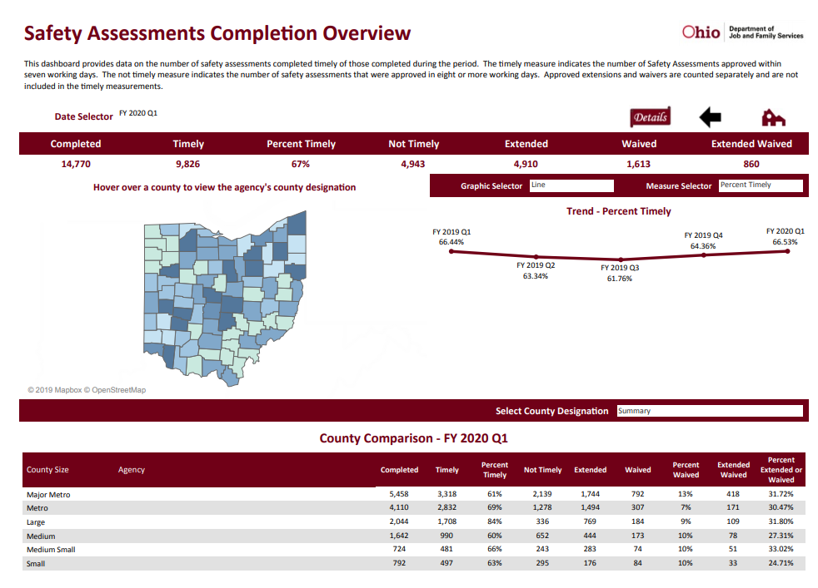
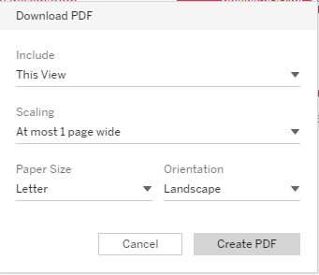
PDF Overview

Slide 44


Crosstab Details
**Click in the Agency Name field prior to clicking on the Download option**

Slide 45
Odds and Ends
If you would like to verify the recipients on the list of employees who have access to the Performance Measure dashboards or would like to change your recipient list, please contact Gaye.Crawford@jfs.ohio.gov
If an employee who has access to these dashboards leaves your agency, please contact the Office of Families and Children so access can be disabled.
Please avoid viewing these dashboards on a smart phone or tablet. As these performance measures are currently constituted within Tableau, the view on a tablet or smartphone will not load correctly.

Slide 46
Contacts:
Chris Beach –
Christopher.Beach@jfs.ohio.gov
Jennifer Watson – Jennifer.Watson@jfs.ohio.gov
Kristine Monroe –
Kristine.Monroe@jfs.ohio.gov

